Slide 1
TRANSFORMERS
Name: Kusuma
Department CSCI Course Number 608 Section 03
DATE: 12/11/2024
Kusuma Reddyvari
608 - Data Science

Slide 2
Name Data Science
608
Contents
Transformers Introduction
Zero Shot Inference
One Shot Inference
Few Shot Inference
Key Differences
Practical Examples for each method
Project demonstration
Conclusion

Slide 3
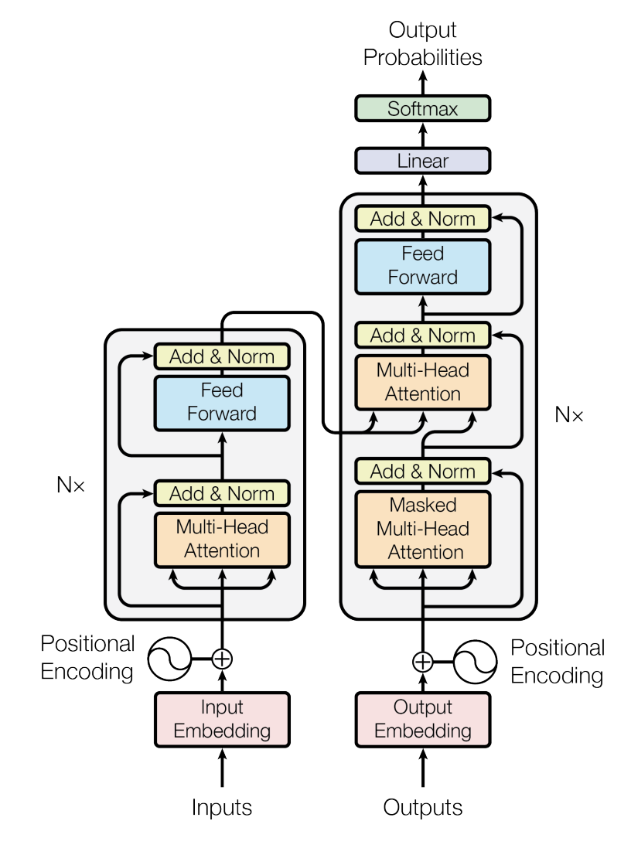
Transformers
Name Data Science
608
Transformers are a type of deep learning model designed for sequence-to-sequence tasks like translation, summarization, or text classification.
They are based on a mechanism called self-attention, which helps the model focus on the most important parts of the input.

Slide 4
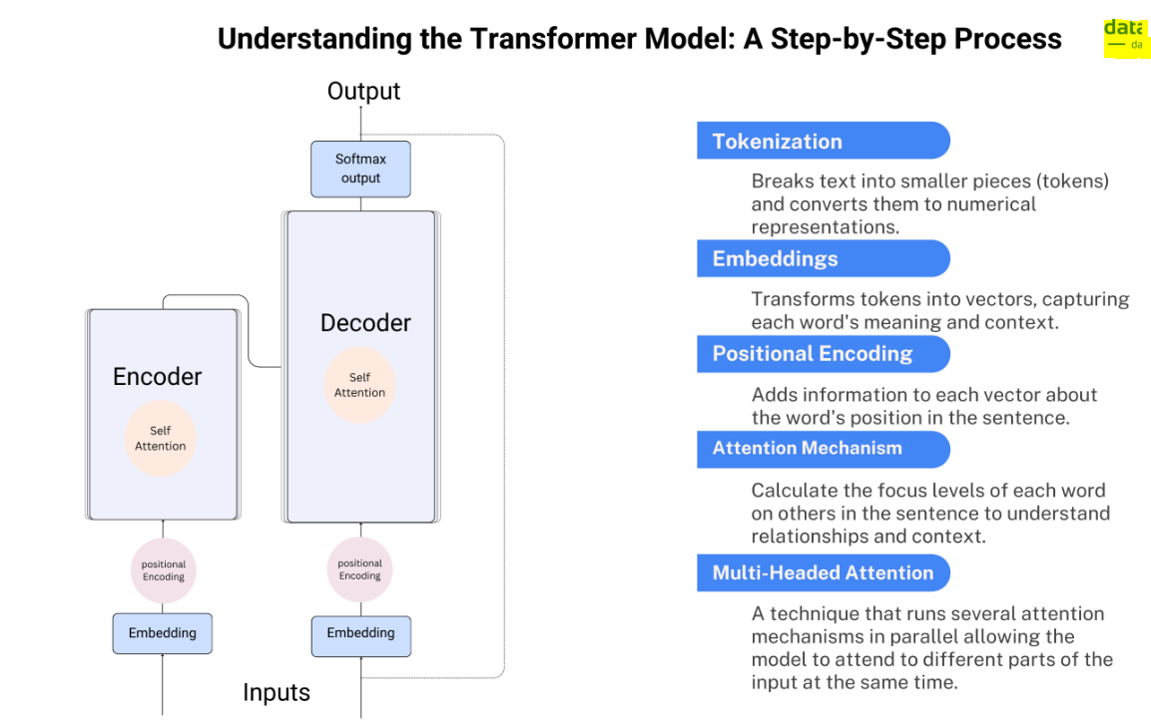
Name Data Science
608

Slide 5
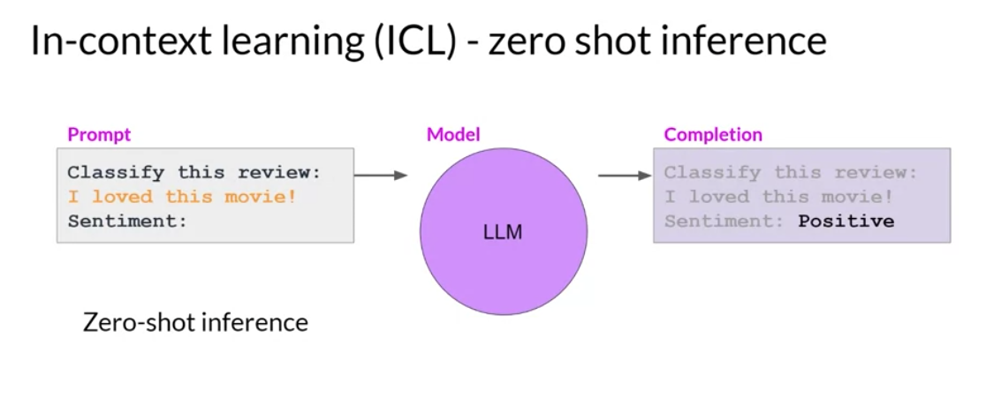
Zero-shot Inference
Name Data Science
608
Zero-shot inference is the ability of a model to make predictions for tasks or categories it has never been explicitly trained on, using only general knowledge from its pre-training.

Slide 6
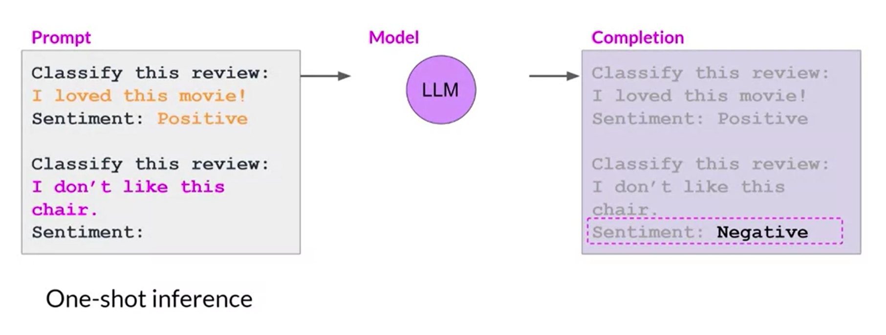
One Shot Inference
Name Data Science
608
One-shot inference is the ability of a model to learn and make predictions for a task or category after being provided with only one labeled example for that task.

Slide 7
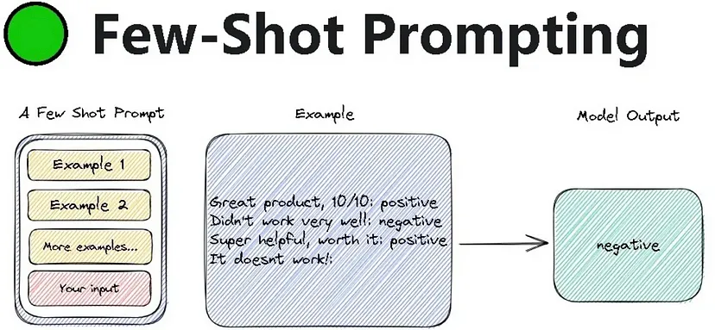
Few-shot Inference
Name Data Science
608
Few-shot inference is the ability of a model to learn and make predictions for a task or category after being provided with a small number of labeled examples, leveraging its pre-trained knowledge for generalization.

Slide 8
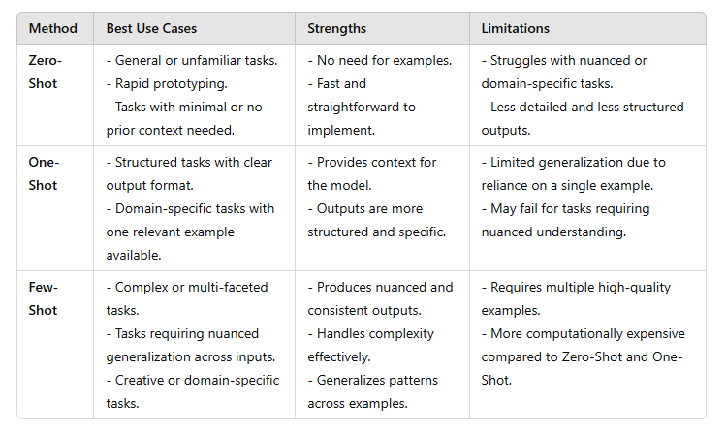
Key Differences
Name Data Science
608

Slide 9
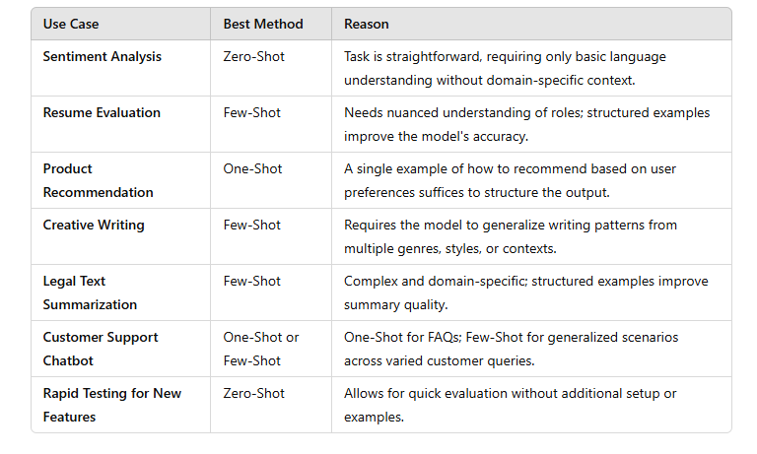
Practical Examples for each method
Name Data Science
608

Slide 10





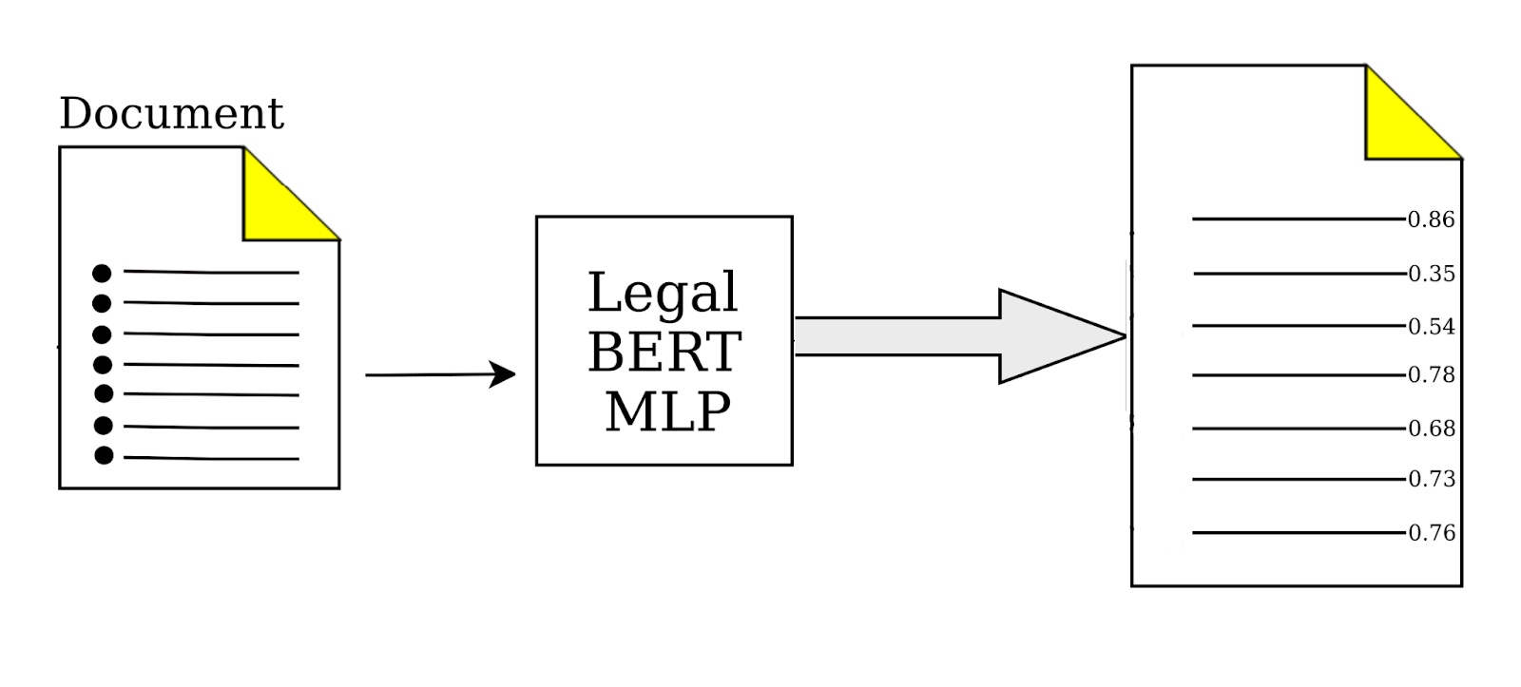
Examples
Name Data Science
608

Slide 11
Name Data Science
608
Project Demonstration

Slide 12
Conclusion
Name Data Science
608
"Zero-Shot, One-Shot, and Few-Shot learning demonstrate the versatility of AI in solving problems with varying levels of complexity. By leveraging the strengths of these methods, we can achieve remarkable outcomes in diverse applications, from recruitment to advanced research."

